Slide 1

I-CHIUN PRECISION INDUSTRY CO.,LTD.
Company Profile

Slide 2

Disclaimer
I-CHIUN’s presentation contains forward-looking statements subject to significant risks and uncertainties. Actual results may differ materially from those contained in the forward-looking statements.
The forward-looking statements in this release reflect the current belief of I-CHIUN as of the date of this release, we undertake no obligation to update these forward-looking statements for new information ,future events, or otherwise.

Slide 3

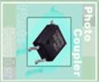
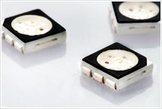


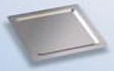
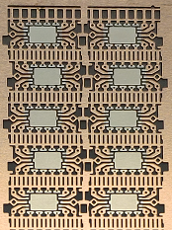
Company Features
Founded | 1977
IPO | March 2000
Business Focus | Lamp LED Frame SMD LED Frame Ceramic circuit board Heat Spreader IC Lead Frame
Headquarter | Taipei, Taiwan
Employees | Approximately 1,600 Worldwide

Slide 4
Company Business Philosophy
Business Philosopy
Honesty
Integrity
Consistency
Company Willing
To be Globe 3C Industry
Professional Innovation
Value Creation
Company Spirits
Honesty
Professional
Innovation
Value

Slide 5
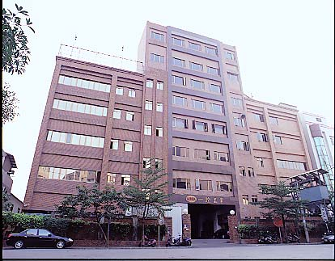
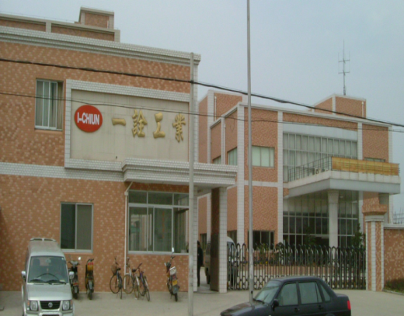
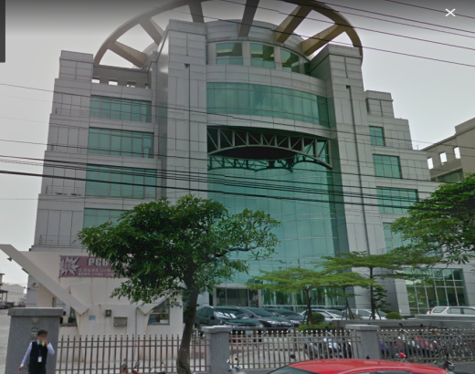
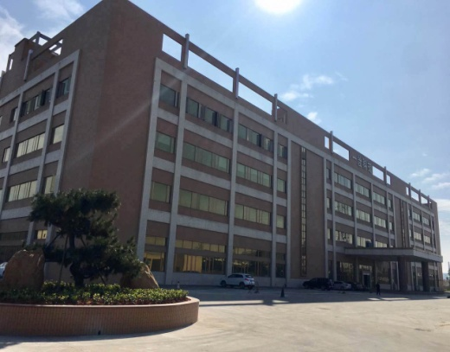
Factory Location
Taipei
Kun Shan
Ecocera
Jiang Men
5

Slide 6



Products
Taipei
LAMP L/F
SMD L/F
Heat Spreader
Kun Shan
LAMP L/F
TV L/B
Ecocera
Ceramic
Circuit board
Jiang Men
LAMP L/F
IC L/F

Slide 7
The Major Markets Distribution
2023
2024Q2

Slide 8
Sales Distribution
2023
2024Q2

Slide 9
Income Statement
 | Financial Information (Thousand NT$)
 | 2024Q2 | 2023 | 2022 | 2021
Sale Revenue | 2,511,376 | 5,068,696 | 5,195,927 | 5,988,398
Gross Profit | 353,206 | 717,114 | 578,280 | 1,168,610
Gross Profit Margin(%) | 14.06% | 14.15% | 11.13% | 19.51%
Operating Income | -74,287 | 176,500 | (1,490) | 534,378
Operating profit to sales(%) | (2.96%) | 3.48% | (0.03%) | 8.92%
Non-operating Income(Expenses) | 121,539 | 67,935 | 131,802 | (80,992)
Income Before Tax | 47,252 | 244,435 | 130,312 | 453,386
Net Income | 29,810 | 198,908 | 91,956 | 383,466
EPS | 0.10 | 0.92 | 0.47 | 1.79

Slide 10
Financial Result
 | 2024Q2VS 2023Q2(Thousand NT$)
 | 2024Q2 | Sales % | 2023Q2 | Sales %
Sale Revenue | 2,511,376 | 100.00% | 2,316,895 | 100.00%
Gross Profit | (2,158,170) | (85.94%) | (1,994,785) | (86.10%)
Gross Profit Margin(%) | 353,206 | 14.06% | 322,110 | 13.90%
Operating Income | (427,493) | (17.02%) | (257,549) | (11.12%)
Operating profit to sales(%) | (74,287) | (2.96%) | 64,561 | 2.79%
Non-operating Income(Expenses) | 121,539 | 4.84% | 55,210 | 2.38%
Income Before Tax | 47,252 | 1.88% | 119,771 | 5.17%
Net Income | 29,810 | 1.19% | 96,560 | 4.17%
EPS | 0.10 |  | 0.48

Slide 11

Financial Ratios
 |  | Financial Information
 |  | 2024Q2 | 2023 | 2022 | 2021
Debt Management Ratios | Debt Ratio(%) | 43.09 | 43.78 | 45.84 | 49.94
 | Long term Debt to Fixed Asset(%) | 396.38 | 297.58 | 303.95 | 317.24
Liquidity Ratios | Current Ratio(%) | 259.38 | 194.82 | 262.04 | 243.75
 | Quick Ratio(%) | 210.25 | 143.47 | 182.59 | 166.69
 | Times Interest Earned | 3.20 | 5.09 | 3.09 | 11.97

Slide 12
Financial Ratios
 |  | Financial Information
 |  | 2024Q2 | 2023 | 2022 | 2021
Asset Management (Times) | Account Receivable Turnover (Times) | 2.32 | 2.51 | 2.38 | 3.00
 | Inventory Turnover (Times) | 3.65 | 3.51 | 3.21 | 4.20
 | Fixed Asset Turnover (Times) | 2.95 | 2.76 | 2.64 | 3.04
 | Total Asset Turnover (Times) | 0.59 | 0.65 | 0.64 | 0.82
Profitability | Return to Asset(%) | 0.94 | 3.17 | 1.74 | 5.72
 | Return to Equity(%) | 0.96 | 4.62 | 2.17 | 10.72
 | Net Profit Margin(%) | 0.92 | 3.92 | 1.77 | 6.40
 | EPS | 0.10 | 0.92 | 0.47 | 1.79

Slide 13
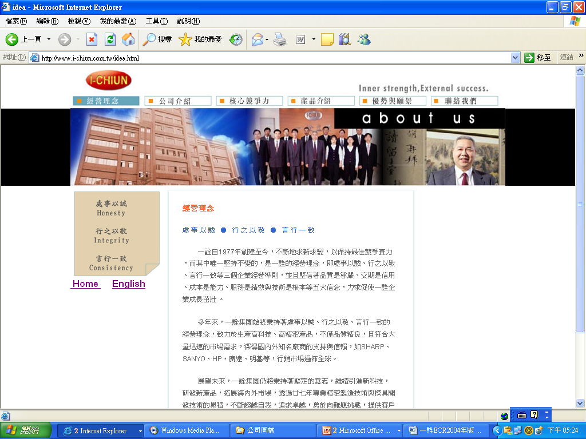

I-CHIUN PRECISION INDUSTRY CO.,LTD.
No.17 Wu Gung 5Rd, Xin Zhuang District, New Taipei City, Taiwan, R.O.C.
TEL: 886-2-2299-0001
FAX: 886-2-2299-4529, 2299-0089
www.i-chiun.com.tw
paijung@i-chiun.com.tw
Thank You

