Slide 1

I-CHIUN PRECISION INDUSTRY CO.,LTD.
Company Profile

Slide 2

Disclaimer
I-CHIUN’s presentation contains forward-looking statements subject to significant risks and uncertainties. Actual results may differ materially from those contained in the forward-looking statements.
The forward-looking statements in this release reflect the current belief of I-CHIUN as of the date of this release, we undertake no obligation to update these forward-looking statements for new information ,future events, or otherwise.

Slide 3

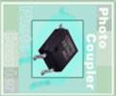
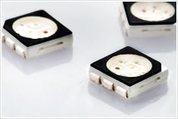


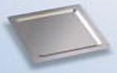
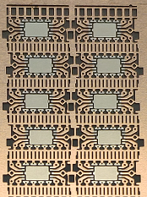
Company Features
Founded | 1977
IPO | March 2000
Business Focus | Lamp LED Frame SMD LED Frame Ceramic circuit board Heat Spreader IC Lead Frame
Headquarter | Taipei, Taiwan
Employees | Approximately 1,650 Worldwide

Slide 4
Company Business Philosophy
Business Philosopy
Honesty
Integrity
Consistency
Company Willing
To be Globe 3C Industry
Professional Innovation
Value Creation
Company Spirits
Honesty
Professional
Innovation
Value

Slide 5
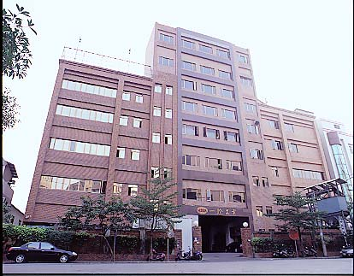
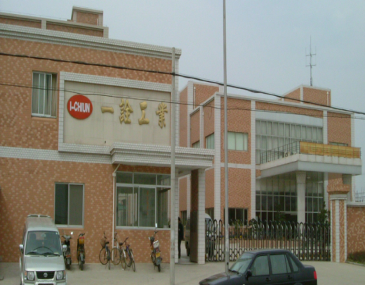
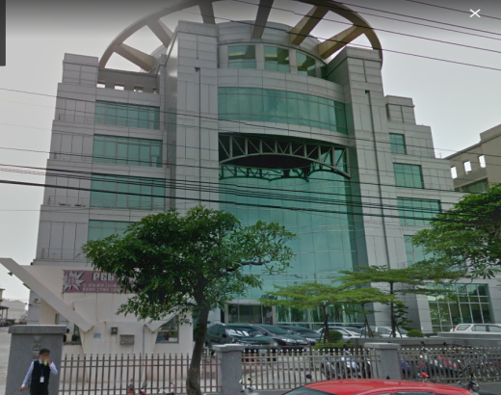
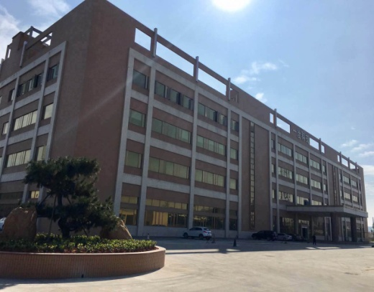
Factory Location
Taipei
Kun Shan
Ecocera
Jiang Men
5

Slide 6



Products
Taipei
LAMP L/F
SMD L/F
Heat Spreader
Kun Shan
LAMP L/F
TV L/B
Ecocera
Ceramic
Circuit board
Jiang Men
LAMP L/F
IC L/F

Slide 7
The Major Markets Distribution
2022
2023Q2

Slide 8
Sales Distribution
2022
2023Q2

Slide 9
Income Statement
 | Financial Information (Thousand NT$)
 | 2023Q2 | 2022 | 2021 | 2020
Sale Revenue | 2,316,895 | 5,195,927 | 5,988,398 | 4,197,470
Gross Profit | 322,110 | 578,280 | 1,168,610 | 520,876
Gross Profit Margin(%) | 13.90% | 11.13% | 19.51% | 12.41%
Operating Income | 64,561 | (1,490) | 534,378 | (47,051)
Operating profit to sales(%) | 2.79% | (0.03%) | 8.92% | (1.12%)
Non-operating Income(Expenses) | 55,210 | 131,802 | (80,992) | (83,618)
Income Before Tax | 119,771 | 130,312 | 453,386 | (130,669)
Net Income | 96,560 | 91,956 | 383,466 | (156,591)
EPS | 0.48 | 0.47 | 1.79 | (0.75)

Slide 10
Financial Result
 | 2023Q2VS 2022Q2(Thousand NT$)
 | 2023Q2 | Sales % | 2022Q2 | Sales %
Sale Revenue | 2,316,895 | 100.00% | 2,772,083 | 100.00%
Gross Profit | (1,994,785) | (86.10%) | (2,424,561) | (87.46%)
Gross Profit Margin(%) | 322,110 | 13.90% | 347,522 | 12.54%
Operating Income | (257,549) | (11.12%) | (337,607) | (12.18%)
Operating profit to sales(%) | 64,561 | 2.79% | 9,915 | 0.36%
Non-operating Income(Expenses) | 55,210 | 2.38% | 84,243 | 3.04%
Income Before Tax | 119,771 | 5.17% | 94,158 | 3.40%
Net Income | 96,560 | 4.17% | 67,874 | 2.45%
EPS | 0.48 |  | 0.32

Slide 11

Financial Ratios
 |  | Financial Information
 |  | 2023Q2 | 2022 | 2021 | 2020
Debt Management Ratios | Debt Ratio(%) | 46.27 | 45.84 | 49.94 | 52.21
 | Long term Debt to Fixed Asset(%) | 306.81 | 303.95 | 317.24 | 214.71
Liquidity Ratios | Current Ratio(%) | 237.04 | 262.04 | 243.75 | 185.82
 | Quick Ratio(%) | 178.99 | 182.59 | 166.69 | 139.65
 | Times Interest Earned | 5.03 | 3.09 | 11.97 | (2.64)

Slide 12
Financial Ratios
 |  | Financial Information
 |  | 2023Q2 | 2022 | 2021 | 2020
Asset Management (Times) | Account Receivable Turnover (Times) | 2.47 | 2.38 | 3.00 | 2.83
 | Inventory Turnover (Times) | 2.95 | 3.21 | 4.20 | 5.19
 | Fixed Asset Turnover (Times) | 2.43 | 2.64 | 3.04 | 2.13
 | Total Asset Turnover (Times) | 0.57 | 0.64 | 0.82 | 0.70
Profitability | Return to Asset(%) | 3.15 | 1.74 | 5.72 | (2.15)
 | Return to Equity(%) | 4.96 | 2.17 | 10.72 | (5.33)
 | Net Profit Margin(%) | 4.49 | 1.77 | 6.40 | (3.73)
 | EPS | 0.48 | 0.47 | 1.79 | (0.75)

Slide 13
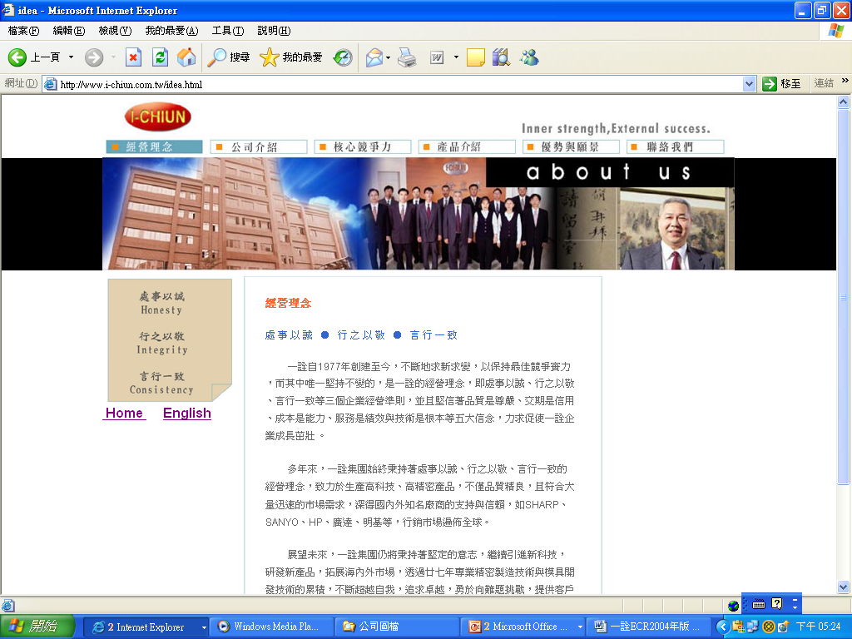

I-CHIUN PRECISION INDUSTRY CO.,LTD.
No.17 Wu Gung 5Rd, Xin Zhuang District, New Taipei City, Taiwan, R.O.C.
TEL: 886-2-2299-0001
FAX: 886-2-2299-4529, 2299-0089
www.i-chiun.com.tw
paijung@i-chiun.com.tw
Thank You

